Slide 1
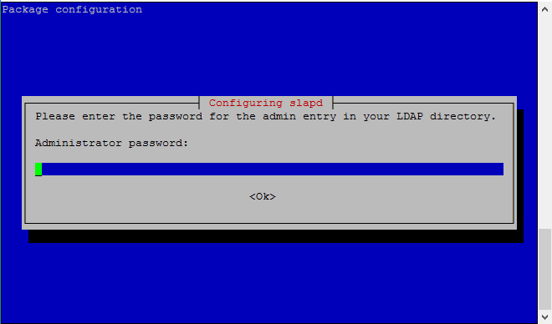
How to Install OpenLDAP
Sudo apt-get update
Sudo apt-get install slapd ldap-utils

Slide 2
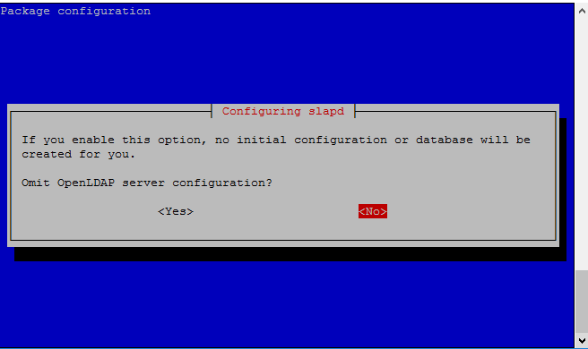
Reconfiguring OpenLDAP
Sudo dpkg-reconfigure slapd

Slide 3
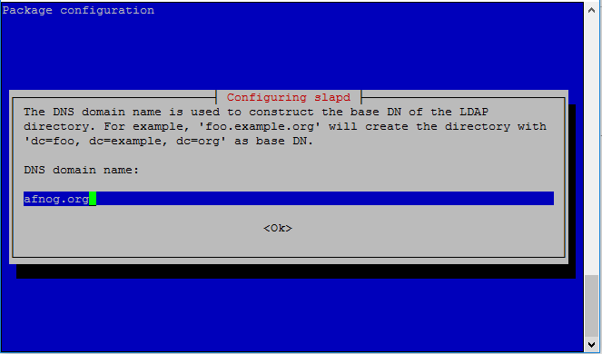
Reconfiguring OpenLDAP Continue

Slide 4
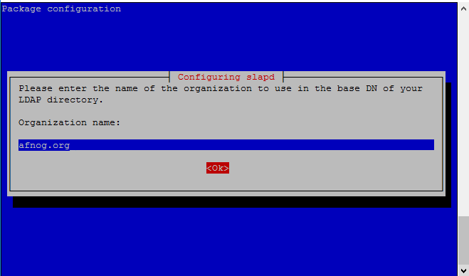
Reconfiguring OpenLDAP Continue

Slide 5
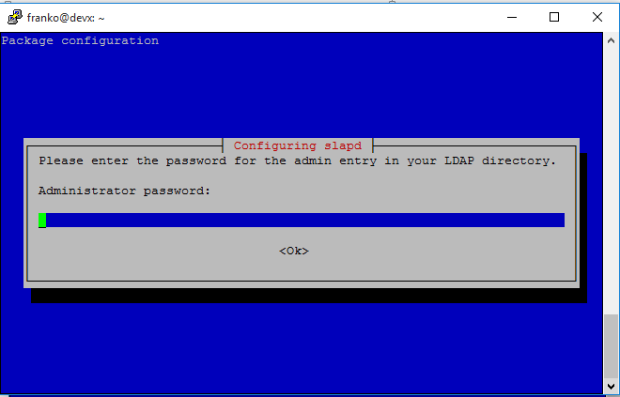
Reconfiguring OpenLDAP Continue

Slide 6
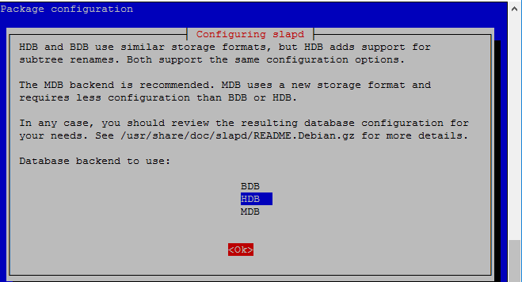
Reconfiguring OpenLDAP Continue

Slide 7
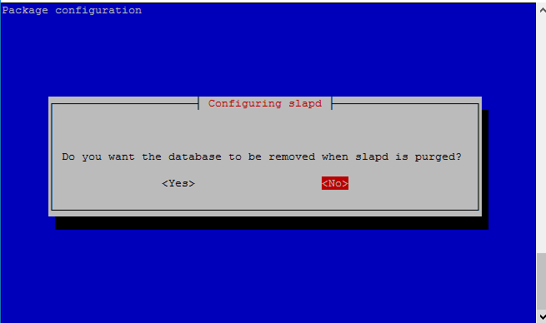
Reconfiguring OpenLDAP Continue

Slide 8
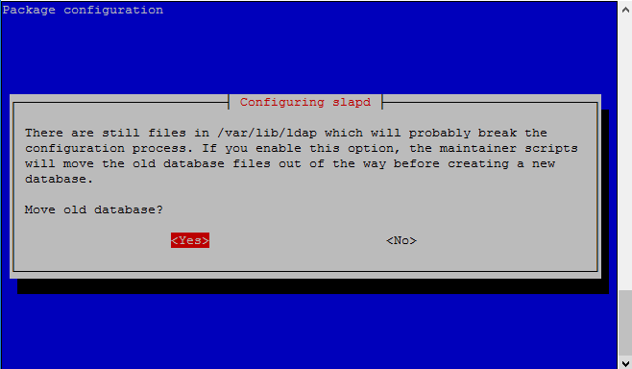
Reconfiguring OpenLDAP Continue

Slide 9
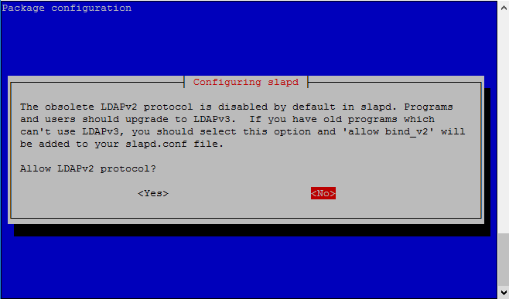
Reconfiguring OpenLDAP Continue

Slide 10
Installing and configuring PhpLdapAdmin
Apt-get install apache2
Apt-get –y install php5 libapache2-mod-php5
Service apache2 restart
Apt-get install phpldapadmin
Vi /etc/phpldapadmin/config.php
Search for the following sections and modify them accordingly.

Slide 11
configuring PhpLdapAdmin continue
Change the red value to the way you will be referencing your server, either through domain name or IP address.

Slide 12
configuring PhpLdapAdmin continue
Edit the following entry to reflect the name you selected (ours is “afnog.org" as you recall):

Slide 13
configuring PhpLdapAdmin continue
The next value to modify will use the same domain components that you just set up in the last entry. Add these after the "cn=admin" in the entry below:

Slide 14
configuring PhpLdapAdmin continue
Search for the following section about the "hidetemplatewarning" attribute. We want to uncomment this line and set the value to "true" to avoid some annoying warnings that are unimportant.

Slide 15

configuring PhpLdapAdmin continue
Login to the PhpLdapAdmin page using a browser with your IP Address followed by phpldapadmin

Slide 16
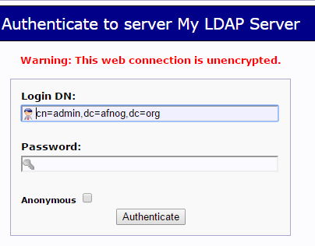
configuring PhpLdapAdmin continue
Click on login in your left pane and enter your ldap admin password

Slide 17
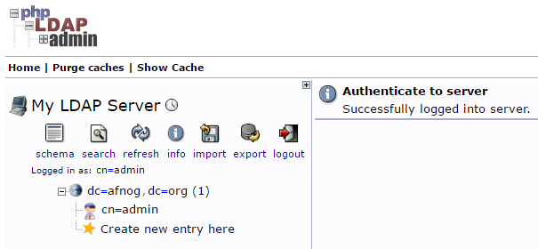
configuring PhpLdapAdmin continue
If successfully loged in, you should see an interface as below

Slide 18
configuring PhpLdapAdmin continue
Create Organizational Units , Groups, Users
Click on the “Create new entry here” link on the left-hand side
Click on the “Generic: Organizational Unit” template as below
We will be asked to create a name for our organizational unit.
Type Groups and repeat the same procedure to create users group as well.
Slides on the next slide demonstrate the process

Slide 19
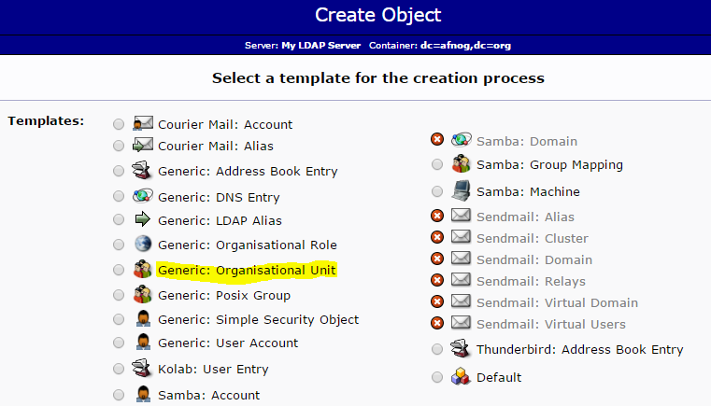
configuring PhpLdapAdmin continue

Slide 20
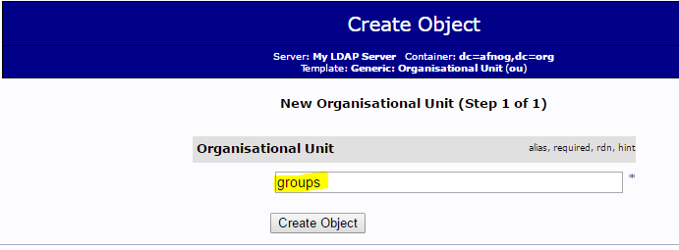
configuring PhpLdapAdmin continue

Slide 21
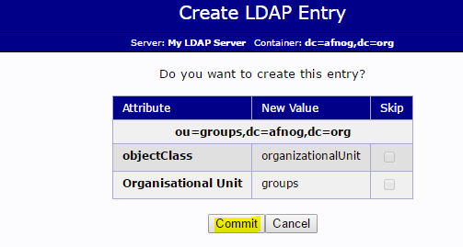
configuring PhpLdapAdmin continue
Click on Commit to save changes

Slide 22
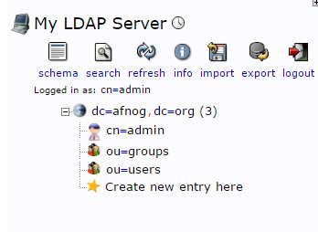
configuring PhpLdapAdmin continue
When you are done, you should see the configuration as shown on your left hand side.

Slide 23
configuring PhpLdapAdmin continue
Create Groups
We can create two different groups that could be used to organize users into different “access” groups based on their privileges they require.
Those groups are “admin” and “user” groups.
In the main pane, click on the “Create a child entry” within the groups category.
We will choose the “Generic: Posix Group” Category
The next slide shows the guidelines for creating those groups.

Slide 24
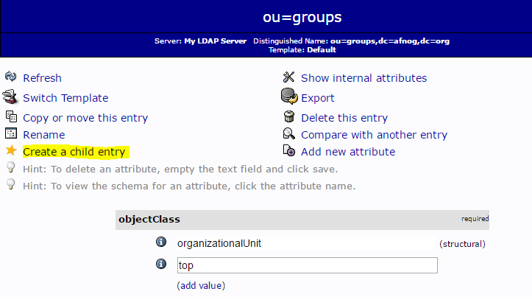
configuring PhpLdapAdmin continue
Click on the “Generic: Posix Group” highlighted in yellow colour

Slide 25
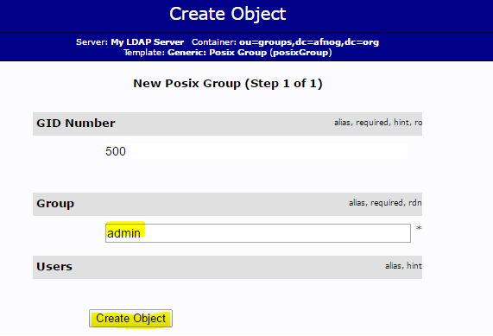
configuring PhpLdapAdmin continue

Slide 26
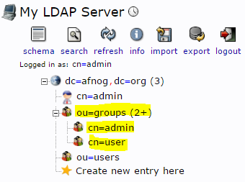
configuring PhpLdapAdmin continue
Both groups after creation will look as below in the left hand side

Slide 27
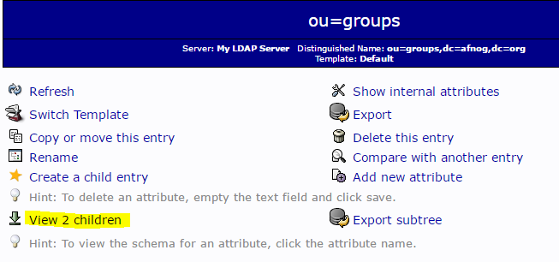
configuring PhpLdapAdmin continue
Click on the “view 2 children” as highlighted in yellow

Slide 28
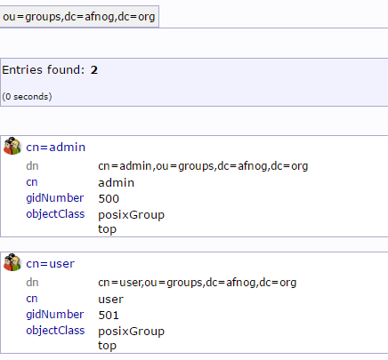
configuring PhpLdapAdmin continue
The output of the view 2 childres is as shown below

Slide 29
Create Users
Next, we will create users to put in these groups. Start by clicking on “ou=users” category. Click on Create a child entry.
We will choose “Generic: User Account” for these entries
We will be given a lot of fields to fill out:
The picture below shows the template to be filled

Slide 30
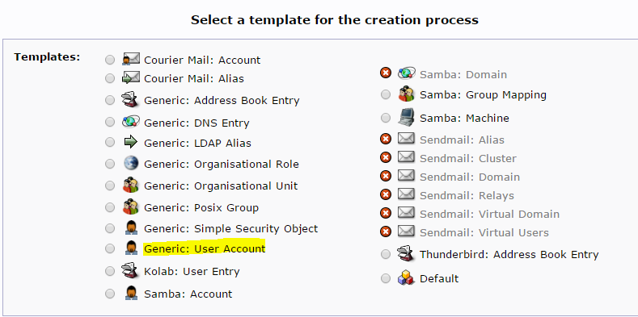

Slide 31
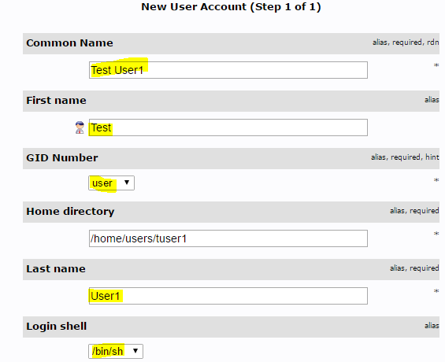

Slide 32
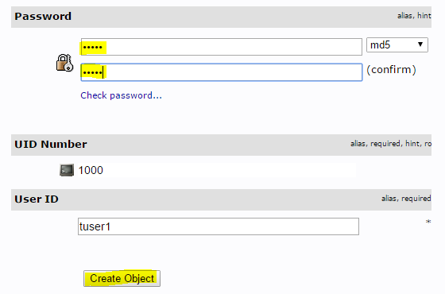

Slide 33
